Slide 1
Lecture 10.4 The principal-agent model

Slide 2
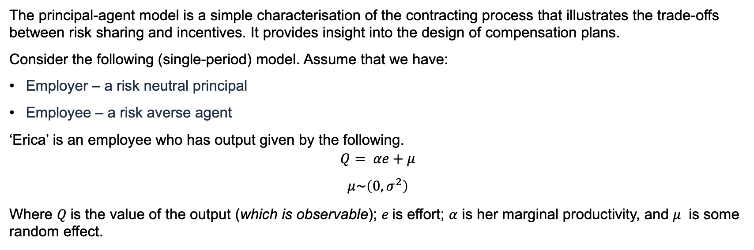
Principal-Agent Model
The principal-agent model is a simple characterisation of the contracting process that illustrates the trade-offs between risk sharing and incentives. It provides insight into the design of compensation plans.
Consider the following (single-period) model. Assume that we have:
Employer – a risk neutral principal
Employee – a risk averse agent
‘Erica’ is an employee who has output given by the following.
$$Q= αe+μ$$
$$μ\sim \left(0, σ^{2}\right)$$
Where $Q$is the value of the output (which is observable); $e$is effort; $α$ is her marginal productivity, and $μ$ is some random effect.

Slide 3
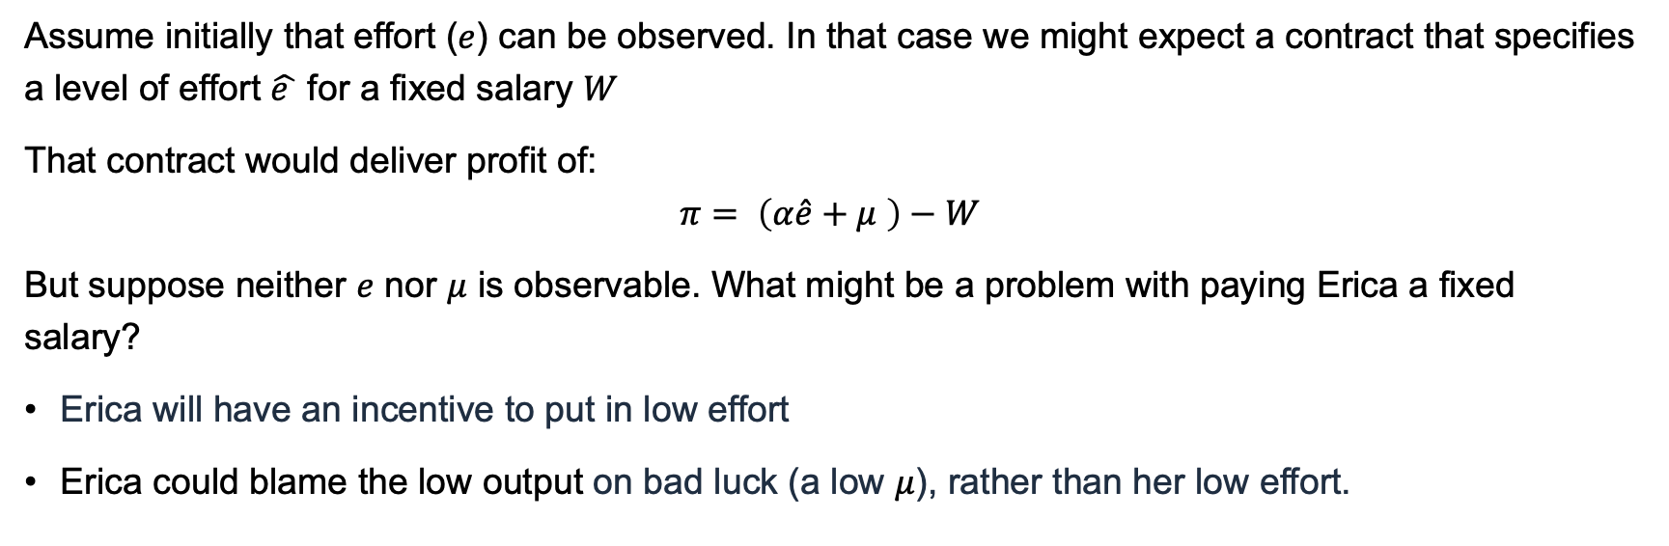
Principal-Agent Model
Assume initially that effort ($e$) can be observed. In that case we might expect a contract that specifies a level of effort $\hat{e }$ for a fixed salary $W$
That contract would deliver profit of:
$$π= \left(α\hat{e}+μ \right)−W$$
But suppose neither $e$ nor $μ$ is observable. What might be a problem with paying Erica a fixed salary?
Erica will have an incentive to put in low effort
Erica could blame the low output on bad luck (a low $μ$), rather than her low effort.

Slide 4
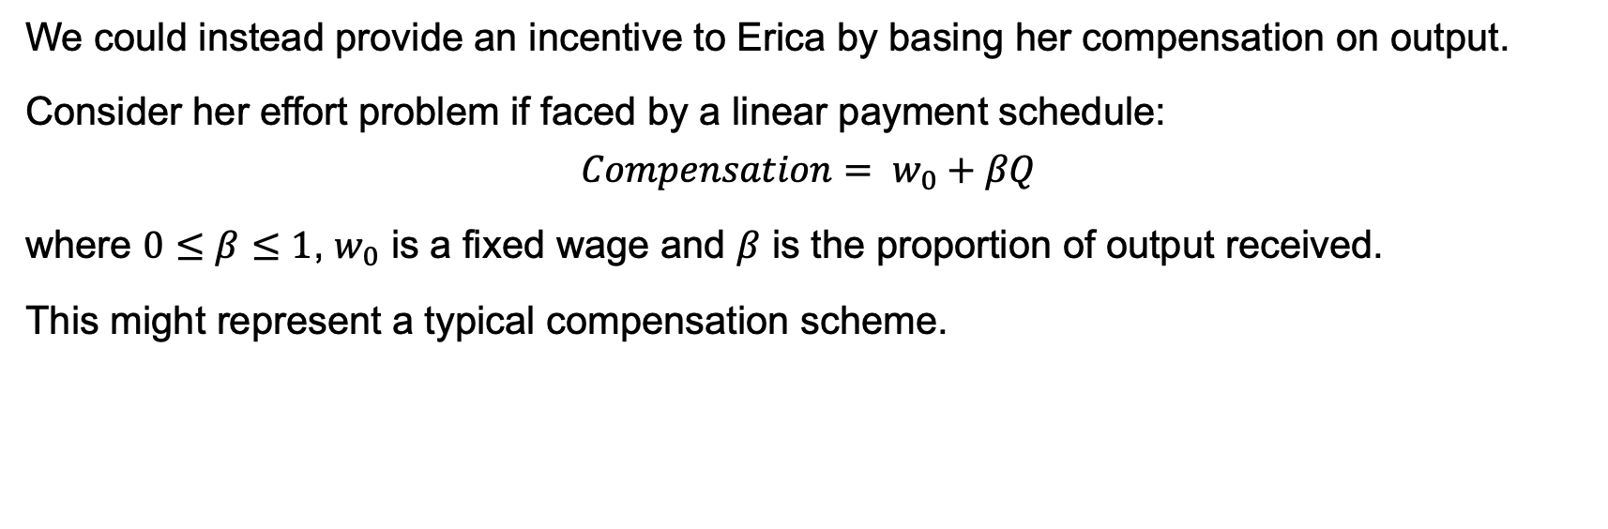
Principal-Agent Model
We could instead provide an incentive to Erica by basing her compensation on output.
Consider her effort problem if faced by a linear payment schedule:
$$Compensation= w_{0}+βQ$$
where $0≤β≤1$, $w_{0}$ is a fixed wage and $β$ is the proportion of output received.
This might represent a typical compensation scheme.

Slide 5
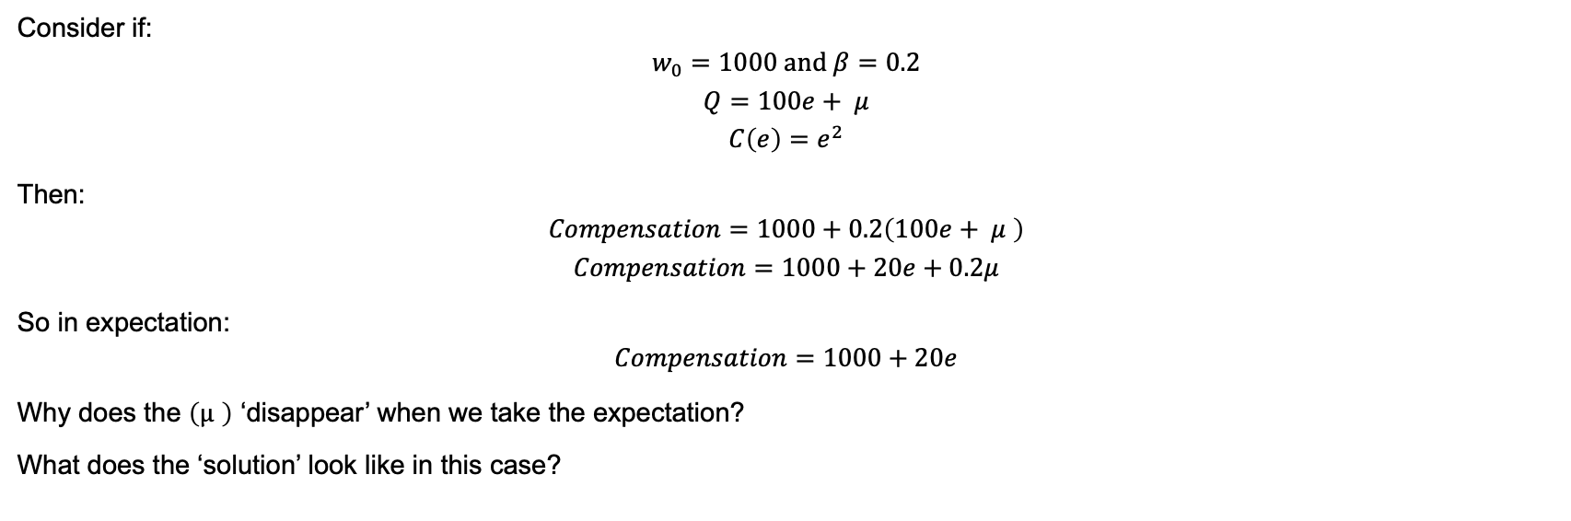
Principal-Agent Model
Consider if:
$$w_{0}=1000 \text{and} β=0.2$$
$$Q=100e+ μ$$
$$C\left(e\right)=e^{2}$$
Then:
$$Compensation=1000+0.2\left(100e+ μ \right)$$
$$Compensation=1000+20e+0.2μ$$
So in expectation:
$$Compensation=1000+20e$$
Why does the $\left(μ \right)$ ‘disappear’ when we take the expectation?
What does the ‘solution’ look like in this case?

Slide 6
($)
Compensation: $1000+$20e
$1200
$1000
Cost of effort
0
e*=10
e (effort)

Slide 7
Compensation: $1250+$20e
($)
Compensation: $1000+$20e
$1200
$1000
Cost of effort
0
e*=10
e (effort)

Slide 8
Compensation: $1000+$30e
($)
Compensation: $1000+$20e
$1200
$1000
Cost of effort
0
e*=10
e*=15
e (effort)

Slide 9
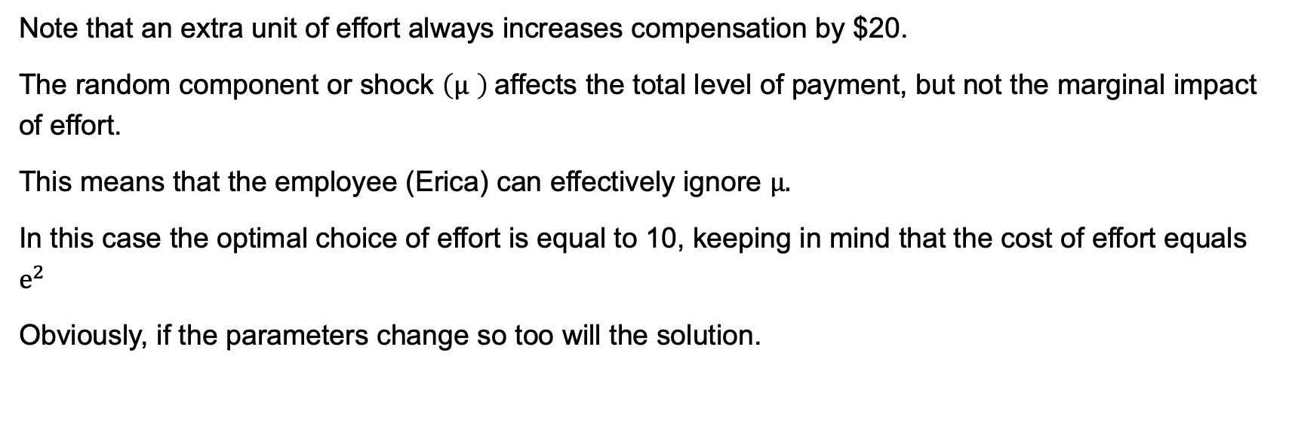
Principal-Agent Model
Note that an extra unit of effort always increases compensation by $20.
The random component or shock $\left(μ \right)$affects the total level of payment, but not the marginal impact of effort.
This means that the employee (Erica) can effectively ignore $μ.$
In this case the optimal choice of effort is equal to 10, keeping in mind that the cost of effort equals $e^{2}$
Obviously, if the parameters change so too will the solution.

Slide 10
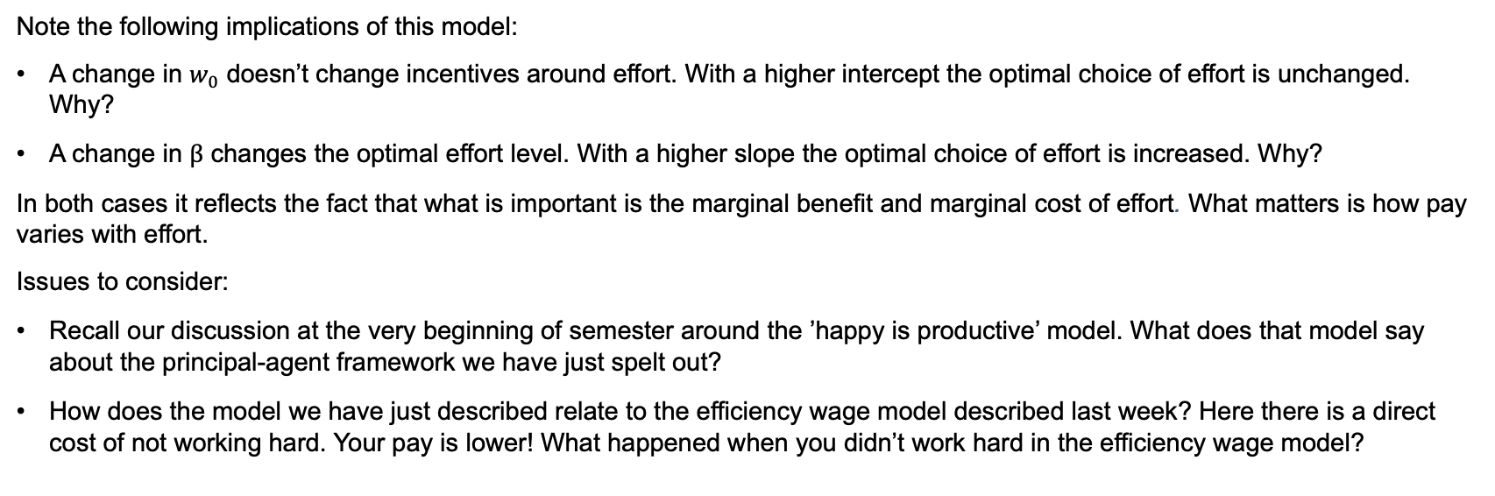
Principal-Agent Model
Note the following implications of this model:
A change in $w_{0}$ doesn’t change incentives around effort. With a higher intercept the optimal choice of effort is unchanged. Why?
A change in $β$ changes the optimal effort level. With a higher slope the optimal choice of effort is increased. Why?
In both cases it reflects the fact that what is important is the marginal benefit and marginal cost of effort. What matters is how pay varies with effort.
Issues to consider:
Recall our discussion at the very beginning of semester around the ’happy is productive’ model. What does that model say about the principal-agent framework we have just spelt out?
How does the model we have just described relate to the efficiency wage model described last week? Here there is a direct cost of not working hard. Your pay is lower! What happened when you didn’t work hard in the efficiency wage model?

Slide 11
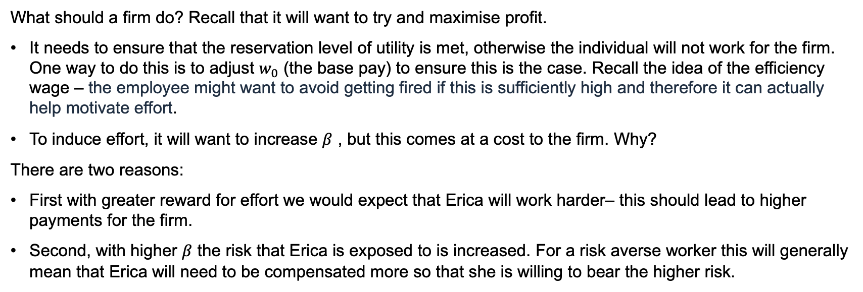
The Optimal Contract
What should a firm do? Recall that it will want to try and maximise profit.
It needs to ensure that the reservation level of utility is met, otherwise the individual will not work for the firm. One way to do this is to adjust $w_{0}$ (the base pay) to ensure this is the case. Recall the idea of the efficiency wage – the employee might want to avoid getting fired if this is sufficiently high and therefore it can actually help motivate effort.
To induce effort, it will want to increase $β$ , but this comes at a cost to the firm. Why?
There are two reasons:
First with greater reward for effort we would expect that Erica will work harder– this should lead to higher payments for the firm.
Second, with higher $β$ the risk that Erica is exposed to is increased. For a risk averse worker this will generally mean that Erica will need to be compensated more so that she is willing to bear the higher risk.

Slide 12
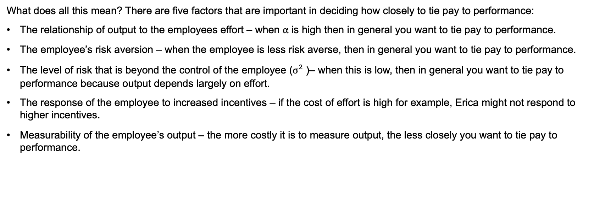
The Optimal Contract
What does all this mean? There are five factors that are important in deciding how closely to tie pay to performance:
The relationship of output to the employees effort – when $α$ is high then in general you want to tie pay to performance.
The employee’s risk aversion – when the employee is less risk averse, then in general you want to tie pay to performance.
The level of risk that is beyond the control of the employee ($σ_{}^{2}$)– when this is low, then in general you want to tie pay to performance because output depends largely on effort.
The response of the employee to increased incentives – if the cost of effort is high for example, Erica might not respond to higher incentives.
Measurability of the employee’s output – the more costly it is to measure output, the less closely you want to tie pay to performance.

